Slide 1
Learn Strategies to Make Your IT Applications More Accessible and Usable Anita Mortaloni Office 365 Engineering Wendy Chisholm C+E Engineering
Notes:
Strategies to make your IT applications more accessible and usable by people of all abilities- Session
Abstract:
Learn how the Office engineering teams approached making all Office 365 applications accessible with scalable techniques, durable engineering processes and a customer first focus.
Talk track
O365 Accessibility Journey
How Office got compliant
Creation of a governance model / accessibility playbook
Transparent Scorecard
Quarterly Executive reviews with Satya
Scalability & Tooling
Trusted Tester Program - Conformance testing, new feature testing to remain compliant
Divide & Conquer with team drivers
Keros for Desktop & Web; Automation, AAT tool?
Focus toward usability & customers
Feedback from people with disabilities – PWD Test passes & Usability studies
Customer Feedback from NGOs, Focus Groups (ATHEN) & Site visits & Insiders
Surveys (NPS, Feature surveys)
Linking Engineering & Customer Support (eDAD)
Culture Change & new Expectations
Inclusive Design into specs (highlight Sway, SharePoint Accessibility 1-2-3 process)
Accessibility starts in Dogfood
Leveraging AI & Intelligent Services

Slide 2
The framework
Clarity
Synergy
Urgency
Notes:
Clarity
Synergy
We are all in this together, we are here to help
Trust but verify
Think “top down, bottoms up”
Clear working group with accountabilities
Track dependencies and investments made across teams
Drive transparency by asking who else needs to know?
Build consensus and approval through empathy and resolving concerns
Urgency
Create an internal or external forcing function (exec reviews, launch conferences)
Timelines with key dates that mark progress
Customer focus

Slide 3
Checklist – Clarity
What has changed?
What metric are you driving?
What are your key principles?
What is your solution that is better than today?
Do you have shared taxonomy and nonmenclature?

Slide 4
Checklist – Synergy
We are in this together and here to help
Top down, bottom up
Clear working group with accountabilities
Drive transparency by asking who else needs to know?
Build consensus and approval through empathy and resolving concerns

Slide 5
Checklist – Urgency
Regular cadence of bring the “outside in.” Activities include:
Timelines with key dates that mark progress
Create an internal or external forcing function (exec reviews, launch conferences)

Slide 6
Checklist – Communication Plan
Vision Document
1:1 meetings
Checkpoint/Alignment Meetings
Status Mails that are relevant

Slide 7


Microsoft Mission
Microsoft Mission
Empower every person and every organization on the planet to achieve more

Slide 8

Empowering People
Every person.
Empowered.
In every context.

Slide 9
Established a process to get compliant
250+ teams
Fixed thousands of bugs
Published 100+ conformance documents
Build new inclusive designed features
Changed the culture across our engineering organization

Slide 10
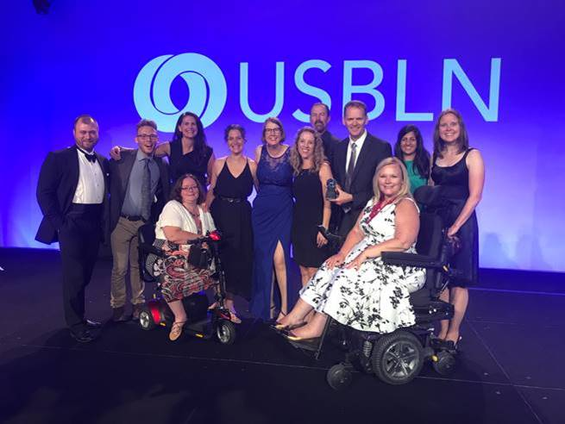
Office 365 products the most compliant and usable versions of our products we have ever shipped.
Notes:
Clint.
This work is winning the hearts and minds of people in the disability community and starting to drive sales and become a key part of our go to market messaging.

Slide 11
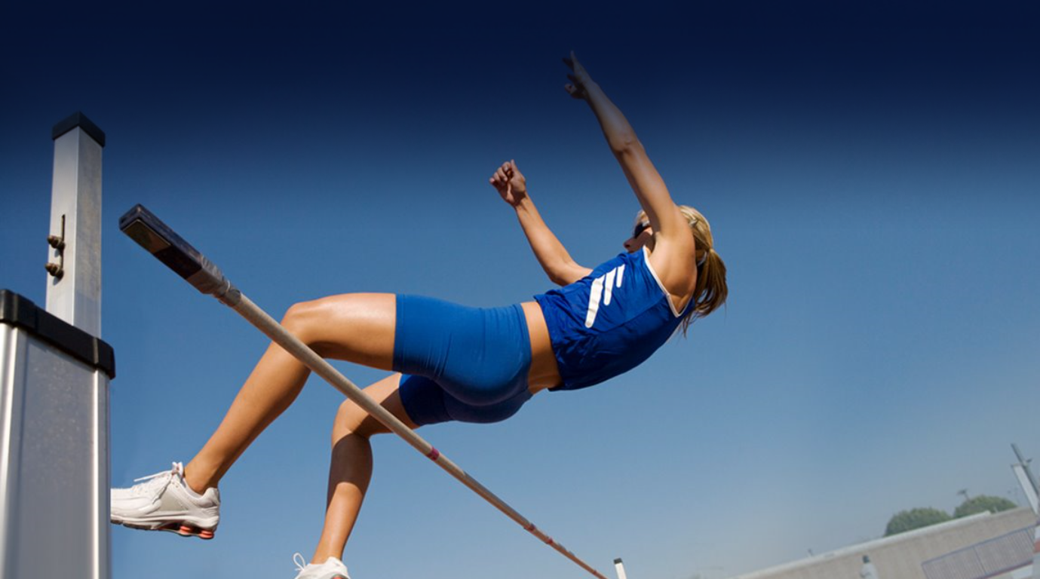
We need to keep doing better
Notes:
@@way to make the text have high contrast but fade the background a bit?

Slide 12

Maintaining Momentum
Notes:
Clarity – NGO compliant
Synergy- dedicated engineering, scorecards and reviews tracking engineering work, part of vision planning
Urgency – engineering, customers

Slide 13
Microsoft Accessibility Playbook
Clarity, synergy and urgency
Governance model
Scalability and tooling
Culture change and new expectations
Focus on customers feedback
Notes:
Culture change and new expectations
Inclusive Design into specs (highlight Sway, SharePoint Accessibility 1-2-3 process)
Accessibility starts in Dogfood
Leveraging AI & Intelligent Services
Accessibility and inclusive design training
Governance model
Scorecard and executive reviews
Focus on customers & usability
Feedback from people with disabilities
Customer feedback from NGO, Focus Groups, Site visits, survey
Linking engineering and customer support
Scalability and tooling
Trusted Tester
Consistency in coverage - Conformance testing
Divide and conquer – drivers
Keros for web/desktop

Slide 14

Office 365 Accessibility Goals & Principles
This Photo by Unknown Author is licensed under CC BY-SA
Notes:
O365 Accessibitliy Goals
People with disabilities can communicate, create, and consume content on any device
It’s easy for everyone to create accessible content
Principles
New experiences are accessible, existing features stay compliant
Conformance statements are accurate and transparent
Deliberate focus on maintaining quality with efficiency of common tasks

Slide 15

Governance Model
This Photo by Unknown Author is licensed under CC BY-SA
Notes:
Single source of truth for content
Visibility and transparency in reporting
Top down bottoms up

Slide 16
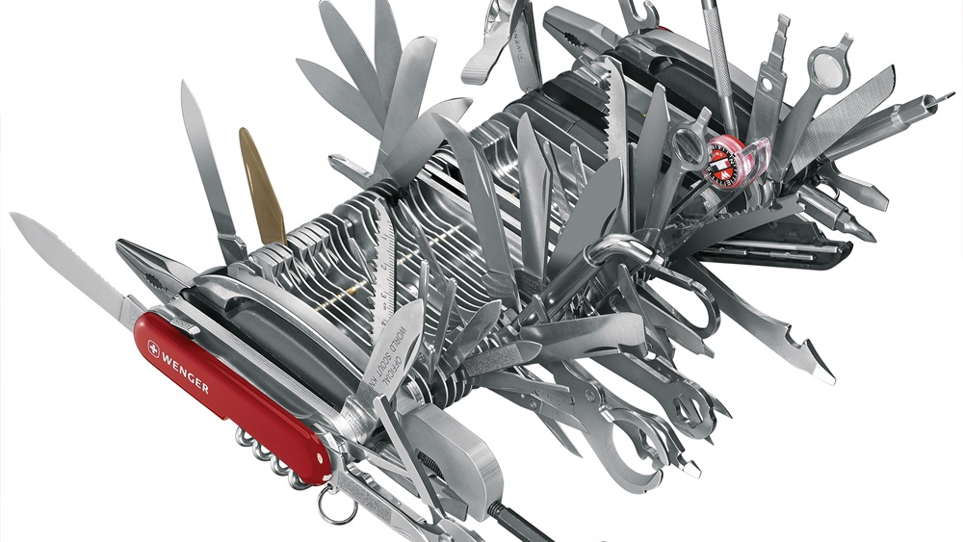
Tools and Scaling
This Photo by Unknown Author is licensed under CC BY-SA
Notes:
Hub and spoke model
Trusted tester
Keros- integrate with engineering

Slide 17
We need comprehensive test process
Clearly Defined Steps
Teachable
Repeatable
Scalable
Code based
Broad Test Coverage

Slide 18
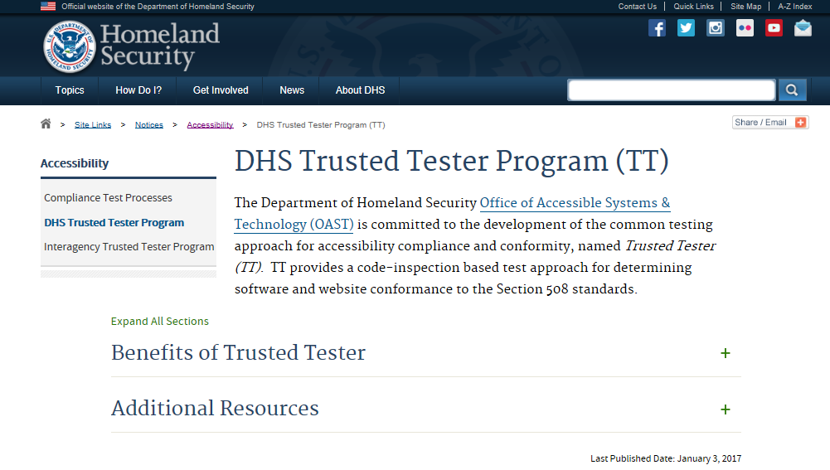
Trusted Tester Program

Slide 19

Accessibility bugs
Overwhelming for developers
==
Barriers for customers
Notes:
Theme: accessibility bugs create pain for both developers and customers.
We’re here to help you
Tooling vision: alleviate pain for both.
Story: 30,000 bugs across the company in FY’17.

Slide 20
1ES Accessibility Vision
Engineering Accessibility Vision
Integrate accessibility throughout​
Accessibility bugs​
Ideally: prevent them​
At a minimum: make it easier to find, fix, and file
Plan
Design
Code
Build &
Deploy
Test
Feedback
Requirements: prevent a11y blockers
Specs: ~70% of a11y issues are design related
FastPass: 2 steps, <5 minutes,
based on aXe
DevOps: integrate into the pipeline
Full assessments: assisted manual tests, suppliers
Listen: Customer walkthroughs, user
voice, eDAD, feedback
Notes:
FastPass: can share the process and not the tool. Part of the shift left process/mindset not necessarily a product.
@@found early success within MSFT, learn more in the Office session

Slide 21
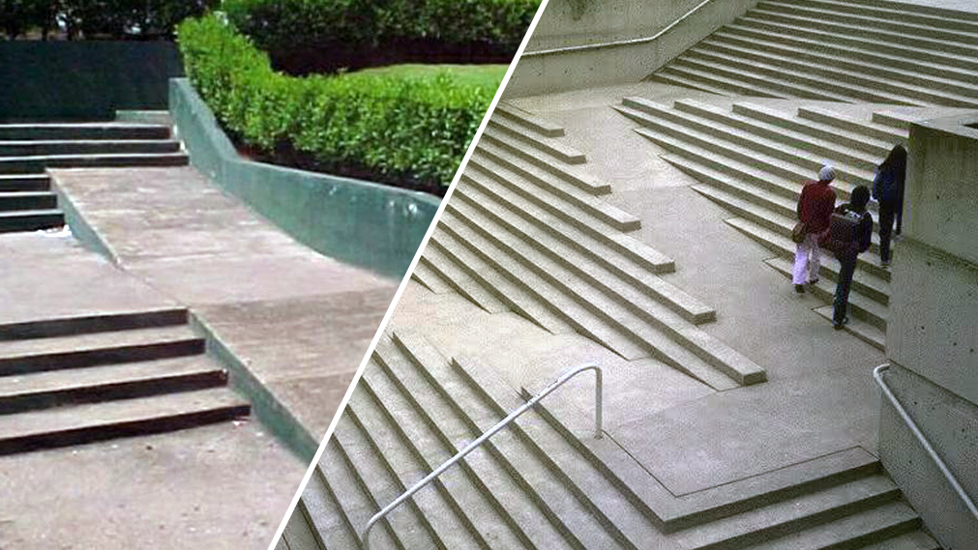
Bolt on vs Built in
Bolt on
Built in
Notes:
Our vision:
PREVENT a11y bugs
OR make it easier to find, file, and fix

Slide 22

Culture change
Connect it to your business
Top down, bottoms up
How it impacts people
Get out of the office
Partner with employee resource groups
Inclusive hiring
Reset expectations on what accessible means
Connect engineering with customer support
Notes:
Accessibility starts in Dogfood
Connect engineering and customer support
Inclusive Design in specs
Leveraging AI & Intelligent Services
Accessibility and inclusive design training

Slide 23

Not all roads are the same on the journey

Slide 24
The framework
Clarity
Synergy
Urgency
Notes:
Clarity
Synergy
We are all in this together, we are here to help
Trust but verify
Think “top down, bottoms up”
Clear working group with accountabilities
Track dependencies and investments made across teams
Drive transparency by asking who else needs to know?
Build consensus and approval through empathy and resolving concerns
Urgency
Create an internal or external forcing function (exec reviews, launch conferences)
Timelines with key dates that mark progress
Customer focus

Slide 25
Checklist – Clarity
What has changed?
What metric are you driving?
What are your key principles?
What is your solution that is better than today?
Do you have shared taxonomy and nonmenclature?

Slide 26
Checklist – Synergy
We are in this together and here to help
Top down, bottom up
Clear working group with accountabilities
Drive transparency by asking who else needs to know?
Build consensus and approval through empathy and resolving concerns

Slide 27
Checklist – Urgency
Regular cadence of bring the “outside in.” Activities include:
Timelines with key dates that mark progress
Create an internal or external forcing function (exec reviews, launch conferences)

Slide 28
Checklist – Communication Plan
Vision Document
1:1 meetings
Checkpoint/Alignment Meetings
Status Mails that are relevant

Slide 29
Resource Links
Trainings and help articles on Office 365: Aka.ms/OfficeAccessibility
PowerPoint add-in for live subtitling: Aka.ms/PresentationTranslator
Tools to improve comprehension: OneNote.com/LearningTools
Dictate add-in for typing in Office with your voice: Dictate.ms
Office Lens app for scanning with OCR: Aka.ms/OfficeLens
Microsoft Accessibility Site Microsoft.com/Accessibility
Twitter for news, insights, and updates @MSFTEnable
Microsoft Presentations at CSUN Aka.ms/CSUN2018
Accessibility support for organizations Aka.ms/Edad
Notes:
Holding slide during presentation Q&A

Slide 30
We want to hear from you.
Connect with us in person today or anytime through our support and feedback channels.
Disability Answer Desk for phone/chat/ASL Help: Aka.ms/AccessibilitySupport
User voice Forum for Accessibility Feedback: Aka.ms/AccessibilityFeedback
Notes:
Holding slide during presentation Q&A

